Slide 1
Ellipsoid method in polynomial time

Slide 2
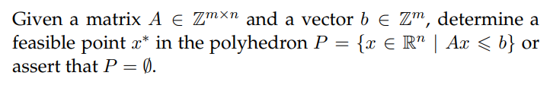
The boundedness and full-dimensionality condition

Slide 3
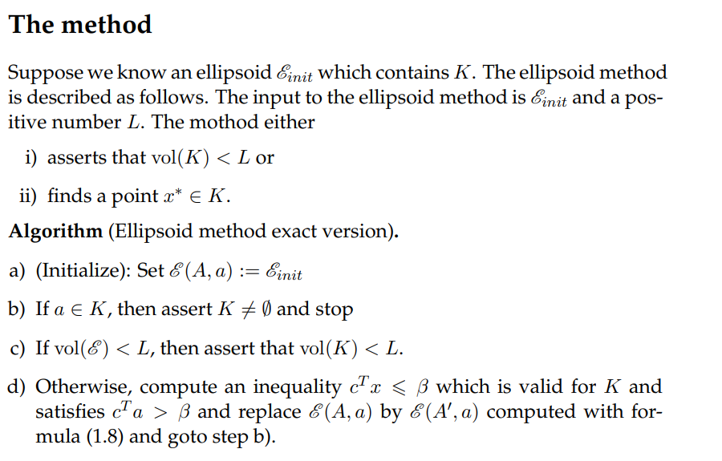

Slide 4
Ellipsoid affine transformation : t(x)=A x +b
E(I,0) E(A,0) E(A,a)

Slide 5
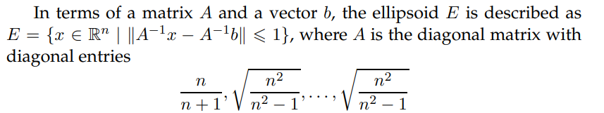
c^{T} x<b< c^{T} a

Slide 6

Why polynomial ?
Then i times iterations:
$\frac{E(i)}{E(init)}≤e^{−i/(2n)} ,let lower bound L replace E(i)$
ln($\frac{\text{L}}{E(init)})≤−i/(2n$)
2n ln($\frac{\text{L}}{E(init)})≤$ $−i$
2nln($\frac{E(init)}{L})≤$ $i$

Slide 7
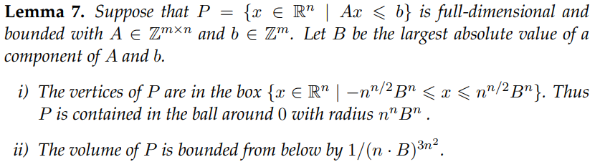


V(E(init)) will be bound in a box with sides length 2(nB)^{n}

Slide 8

$\frac{E(init)}{L}≤$ ${\text{(}\text{2}\text{nB}\text{)}}^{{4n}^{2}}$
O(2nln(${\text{2}\text{nB}\text{)}}^{{4n}^{2}})$
O(8n³ ln(2nB))
O(n³ ln(nB)) polynomial!

Slide 9


Upper bound
Cramer’s rule:
Hadamard inequality:

Slide 10


Upper bound
if B is the largest absolute value of an entry in A:
$\left[\begin{matrix}B \\ B\end{matrix}\right]$ ((B² *n)^{1/2} )^{n}

Slide 11
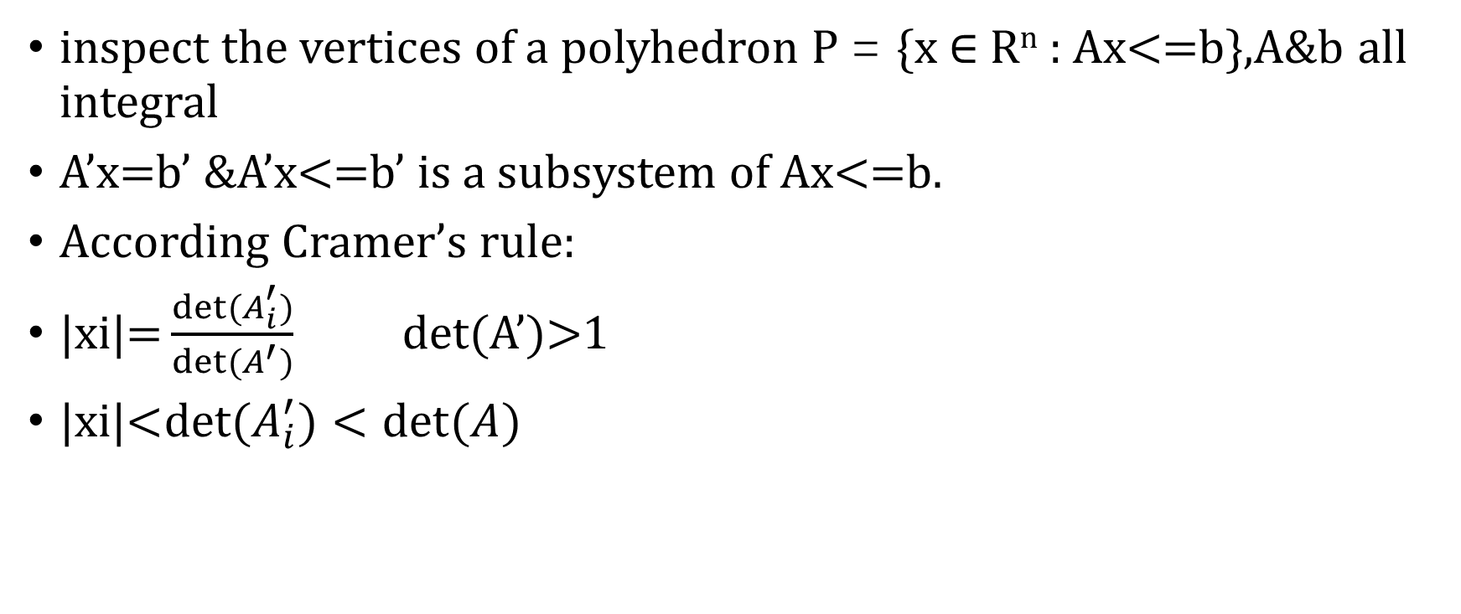
Upper bound
inspect the vertices of a polyhedron P = {x ∈ R^{n} : Ax<=b},A&b all integral
A’x=b’ &A’x<=b’ is a subsystem of Ax<=b.
According Cramer’s rule:
$\text{|}\text{xi}\text{|=}\frac{{det⁡(A}_{i}^{′})}{det⁡(A^{′})}$ det(A’)>1
$\text{|}\text{xi}\text{|<}{det⁡(A}_{i}^{′})<det(A$)

Slide 12
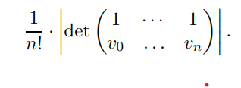

Lower bound
Since P is full dimensional, there exist n + 1 affinely independent vertices v0, . . . , vn of P which span a simplex in R^{n} .
Volume of the simplex:

Slide 13
Reference
[1] M. Grötschel, L. Lovász, and A. Schrijver. Geometric Algorithms and Combinatorial Optimization, volume 2 of Algorithms and Combinatorics. Springer, 1988.
[2] L. Khachiyan. A polynomial algorithm in linear programming. Doklady Akademii Nauk SSSR, 244:1093–1097, 1979

